Slide 1
Alaska Regions
Regions note grid

Slide 2
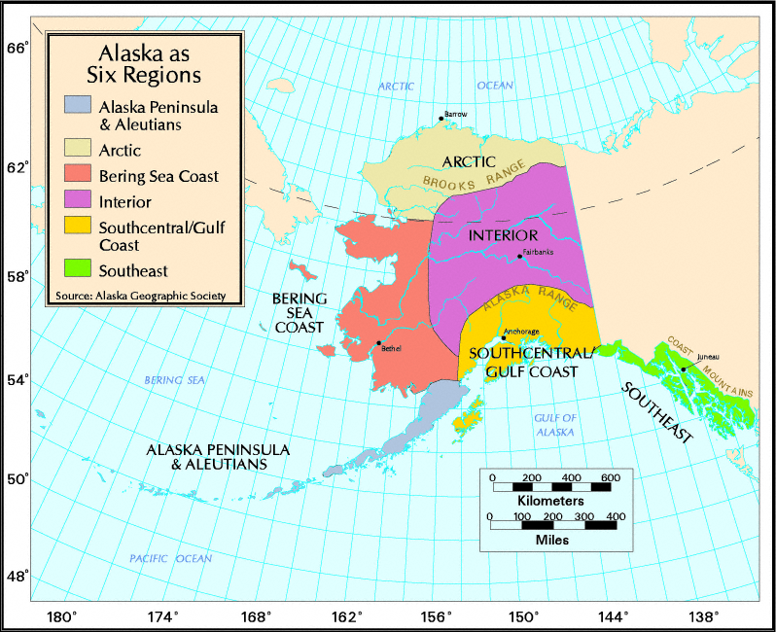

Slide 3
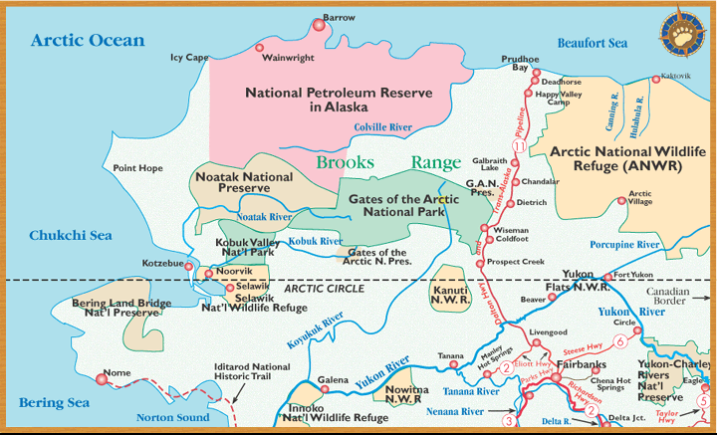
Arctic

Slide 4
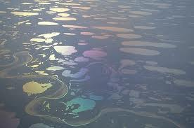
Arctic Geography
Northern Section: Broad Coastal Plain
Bordered by Brooks Range
Treeless
Permafrost
Lakes and Ponds throughout tundra
Fierce storms and Sandy Ridges on the Coast

Slide 5
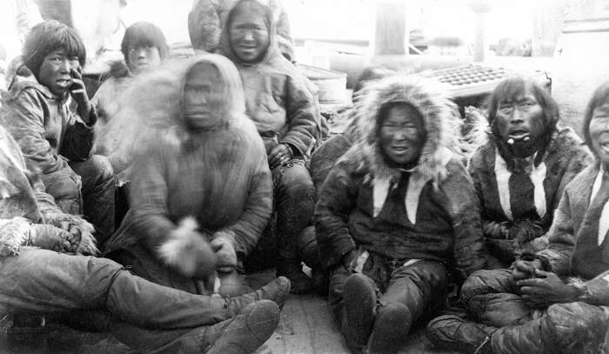
Arctic Native Groups
Inupiat
Yupik

Slide 6
Plants and Animals
Tundra
Caribou
Whales
Polar bears
Bearded seals
Musk oxen
Wolves

Slide 7
Major cities and Hubs
Utqiagvik (Barrow) – the furthest north city in the U.S.
Kotzebue
Prudhoe Bay
Anaktuvuk Pass

Slide 8
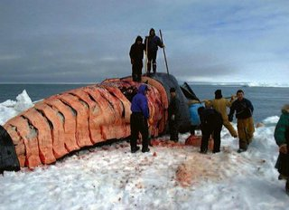
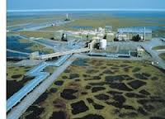
Economic Base
Oil and Minerals
Subsistence fishing and hunting
Whaling

Slide 9
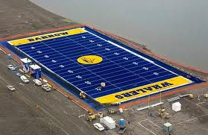
Climate and Weather of the Arctic
Arctic climate
Extreme Cold in winter
Short, cool summers
The sun sets on November 18th and does not rise until January 24th
On May 10th the sun rises and does not set until August 2nd

Slide 10
Your Questions

Slide 11
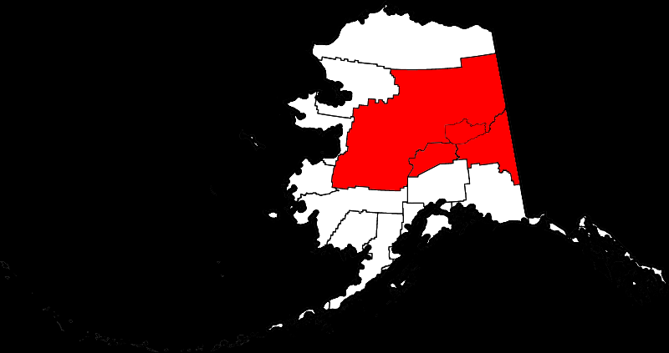
Interior

Slide 12
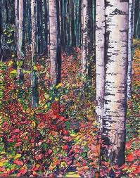
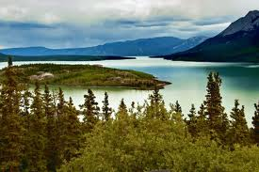
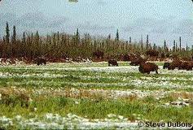
Interior Geography
This region covers about 2/3 of the state
The Arctic Circle cuts across the region
Large Rivers and valleys, Mountain Chains (Denali) Spruce and Birch Forests
The Yukon River
Tundra

Slide 13
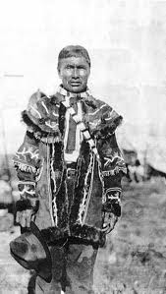
Interior Native Groups
Athabascans

Slide 14
Plants and Animals
Wet and dry tundra
Forests of skinny birch, spruce aspen and alder
Bears
Moose
Wolves
Caribou
Salmon and other fish

Slide 15
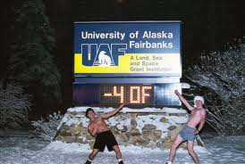
Climate and Weather Interior
Continental subarctic climate
Extreme temperatures
Little precipitation
Some of the hottest and coldest temperatures occur near Fairbanks

Slide 16
Major Cities and Hubs
Fairbanks – the Golden Heart City

Slide 17
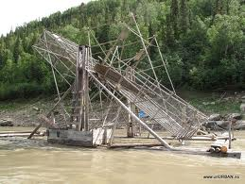
Economic Base Interior
Communication and transportation hubs in Fairbanks
UAF
Oilfield Services
Subsistence fishing and hunting
Minerals

Slide 18
Your Questions

Slide 19
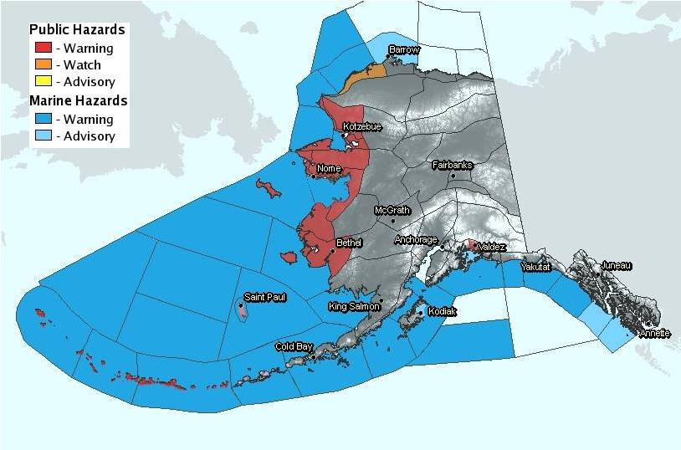
Bering Sea Coast

Slide 20
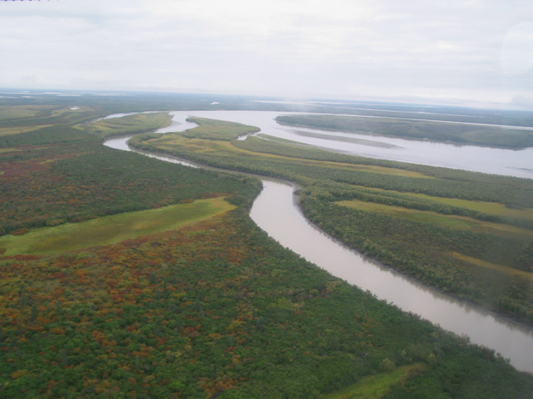
Geography Bering Sea
Extends from the Arctic Circle to Bristol Bay
Flat Tundra, lakes, ponds, and rivers
Dominated by Kuskokwim and Yukon Rivers

Slide 21
Bering Sea Native Groups
Inupiat and Yupiit

Slide 22
Plants and Animals
Brown bears
Walrus
Otters
Fur seals
Seabirds
Salmon and other fish
Musk Oxen

Slide 23
Major cities and hubs
Nome
Dillingham
Bethel
Many small villages
Only a few local roads can be found

Slide 24
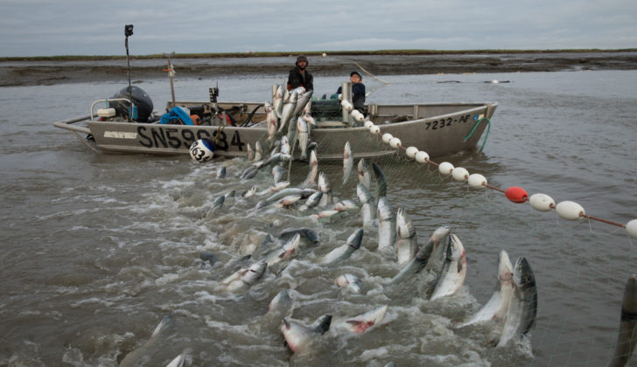
Economic Base Bering Sea Coast
Subsistence Fishing and Hunting
Commercial Fishing
Mineral Development

Slide 25
Bering Sea Coast Climate
Subarctic oceanic climate
Cold, windy winters
Cool and rainy in summer

Slide 26
Your Questions

Slide 27
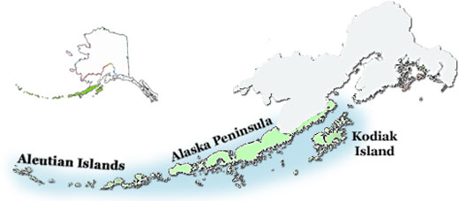
Alaska Peninsula and Aleutians

Slide 28
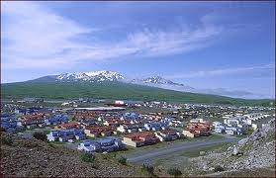
Geography
Volcanic Mountain Ranges
Sits on top of the Ring of Fire
Nearly 1,500 miles long
Islands with rocky shoals and deep channels

Slide 29
Climate and Weather
Mild temperature compared to the arctic
Some of the worst storms in the world

Slide 30
Major Cities and Hubs
Dutch Harbor
Kodiak

Slide 31
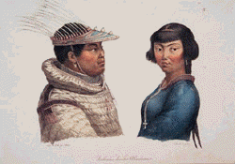
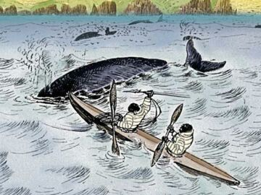
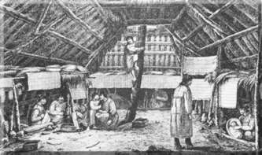
Aleutians Inhabitants
Aleuts: Unangan and Alutiiq

Slide 32
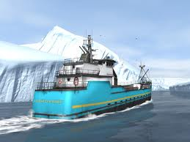
Economic Base
Commercial Fishing
Hunting
Shipping

Slide 33
Plants and Animals
Crab
Fish
Steller sea lion
Sea otter
Sea birds
Puffins
Walrus

Slide 34
Your Questions

Slide 35
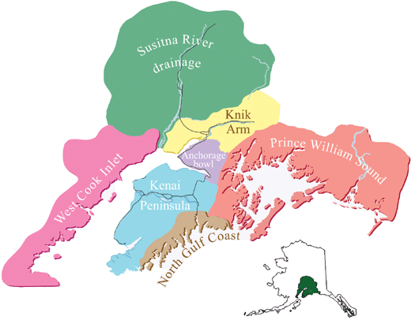
South Central and Gulf Coast

Slide 36
South central Geographic Features
Islands and rough coastline, northern reach of the rainforest extending to Turnagain Arm
Glacial terminus forming the Anchorage Bowl
Mountains and Glaciers with a broad plain extending between the Matanuska and Susitna Rivers

Slide 37
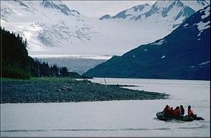
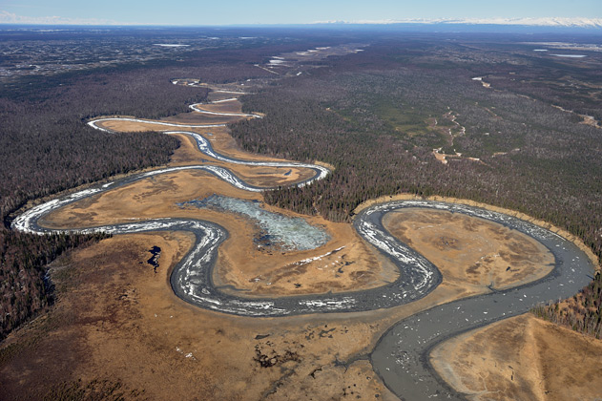

Slide 38
Major cities and Hubs
Anchorage
Seward
Valdez
Wasilla

Slide 39
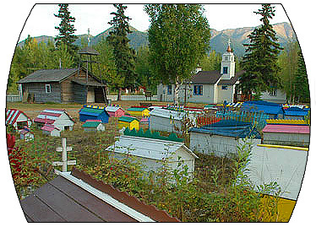
South Central Native Groups
Dena’ina and Alutiiq

Slide 40
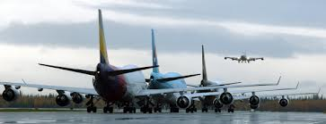
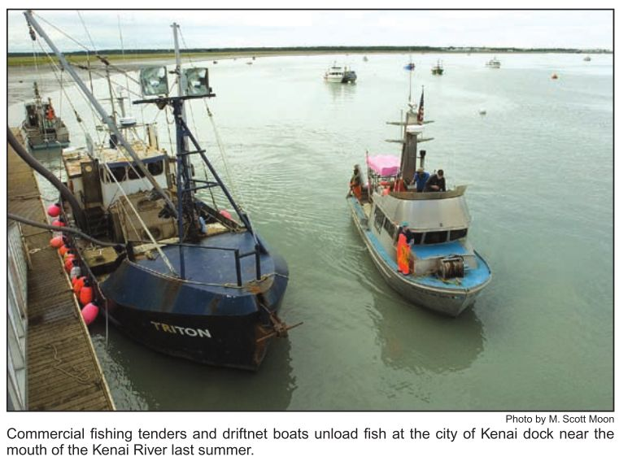
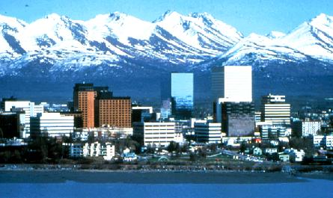
South Central Economics
Communication
Transportation
Fishing
Federal Government
Real estate
Tourism
Oil Services

Slide 41
Plants and Animals
Moose
Brown bears
Black bears
Eagles
Sea birds
Dall Sheep
Whales

Slide 42
Climate and Weather South Central
Mixed continental/coastal climate with medium precipitation and moderate to severe temperatures

Slide 43
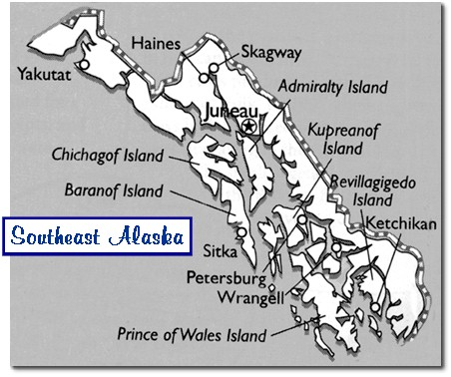
Southeast

Slide 44
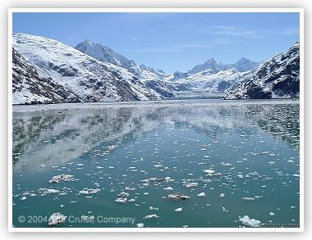
Southeast Geography
Mountains
Fjords
Salmon Streams
Narrow inside passages
Glaciers
Islands

Slide 45
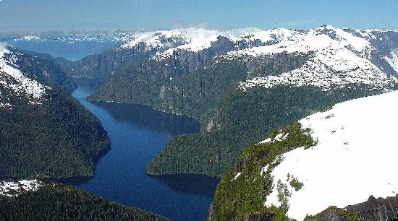
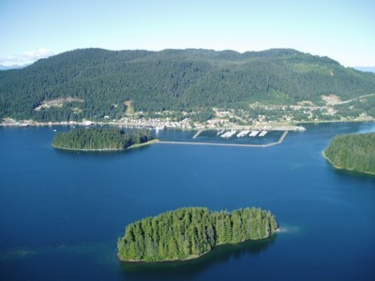

Slide 46
Cities and Major Hubs
Juneau
Sitka
Ketchikan

Slide 47
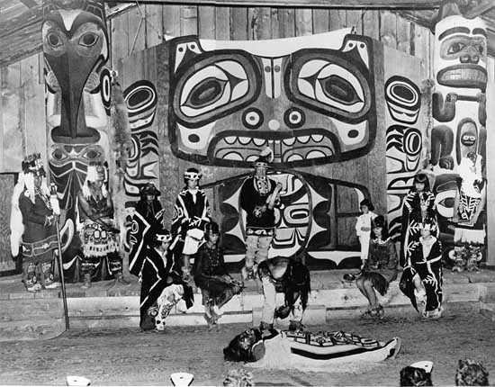
Southeast Inhabitants
Tlingits, Haidas, Tsimshians
http://sheldonmuseum.org/

Slide 48
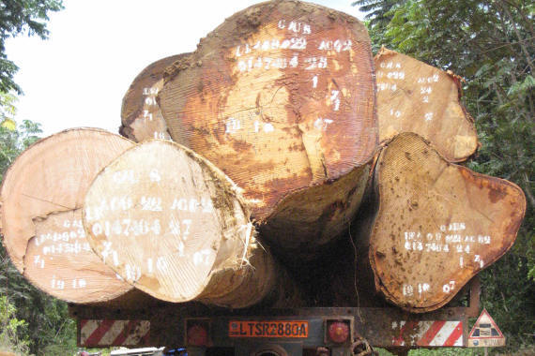
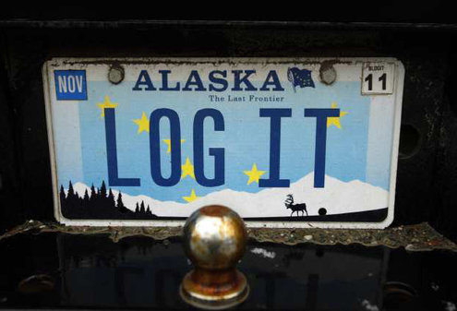
Southeast Economic Base
State Government
Fishing
Tourism
Timber

Slide 49
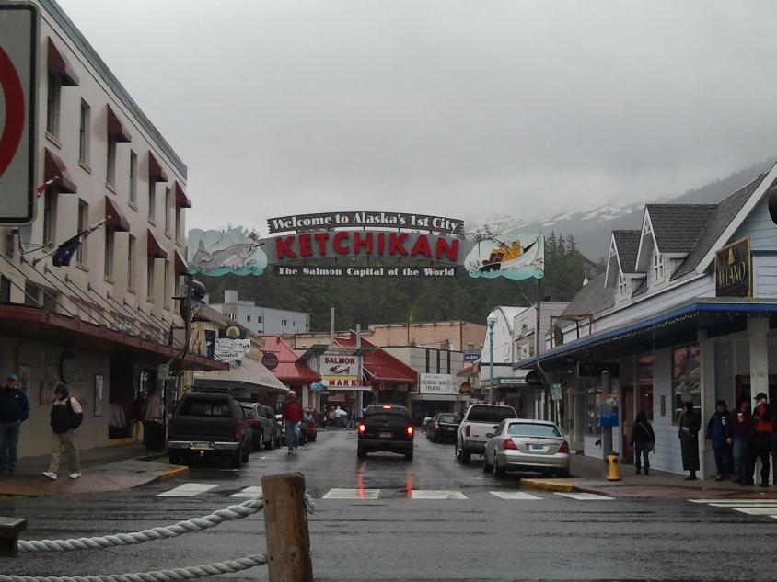
Southeast Climate and Weather
Mid-latitude oceanic climate in the south
Oceanic marine subpolar climate in the northern parts
Mostly temperate rainforests
High precipitation, relatively warm
This is the warmest and wettest part of Alaska

Slide 50
Plants and Animals
Sea lions
Sea otters
Brown bears
Black bears
Whales
Sea birds
Sitka black tailed deer

