Slide 1
Chapter 6: Prices Section 1

Slide 2
Objectives
Explain how supply and demand create equilibrium in the marketplace.
Describe what happens to prices when equilibrium is disturbed.
Identify two ways that the government intervenes in markets to control prices.
Analyze the impact of price ceilings and price floors on a free market.

Slide 3
Key Terms
equilibrium: the point at which the demand for a product or service is equal to the supply of that product or service
disequilibrium: any price or quantity not at equilibrium
shortage: when quantity demanded is more than quantity supplied
surplus: when quantity supplied is more than quantity demanded

Slide 4
Key Terms, cont.
price ceiling: a maximum price that can legally be charged for a good or service
rent control: a price ceiling placed on apartment rent
price floor: a minimum price for a good or service
minimum wage: a minimum price that an employer can pay a worker for one hour of labor

Slide 5
Introduction
What factors affect price?
Prices are affected by the laws of supply and demand.
They are also affected by actions of the government.
Often times the government will intervene to set a minimum or maximum price for a good or service.

Slide 6
What is Equilibrium?

Slide 7
Equilibrium
In order to find the equilibrium price and quantity, you can use supply and demand schedules.
When a market is at equilibrium, both buyers and sellers benefit.
How many slices are sold at equilibrium?
Notes:
Answer: 200

Slide 8
Disequilibrium
Checkpoint: What market condition might cause a pizzeria owner to throw out many slices of pizza at the end of the day?
If the market price or quantity supplied is anywhere but at equilibrium, the market is said to be at disequilibrium.
Disequilibrium can produce two possible outcomes:
Shortage—A shortage causes prices to rise as the demand for a good is greater than the supply of that good.
Surplus—A surplus causes a drop in prices as the supply for a good is greater than the demand for that good.
Notes:
Checkpoint Answer: A surplus

Slide 9
Shortage and Surplus
Shortage and surplus both lead to a market with fewer sales than at equilibrium.
How much is the shortage when pizza is sold at $2.00 per slice?
Notes:
Answers: The shortage is 100 slices of pizza.

Slide 10
Price Ceiling
While markets tend toward equilibrium on their own, sometimes the government intervenes and sets market prices. Price ceilings are one way the government controls prices.
Rent Control
Sets a price ceiling on apartment rent
Prevents inflation during housing crises
Helps the poor cut their housing costs
Can lead to poorly managed buildings because landlords cannot afford the upkeep.

Slide 11
The Effects of Rent Control

Slide 12
Price Floors
A price floor is a minimum price set by the government. The minimum wage is an example of a price floor.
Minimum wage affects the demand and the supply of workers.
At what wage is the labor market at equilibrium?
Notes:
Answer: $6.60.

Slide 13
Price Supports in Agriculture
Price supports in agriculture are another example of a price floor.
They began during the Great Depression to create demand for crops.
Opponents of price supports argue that the regulations dictate to farmers what they should produce.
Supporters say that without government intervention, farmers would overproduce.

Slide 14
Review
Now that you have learned about the factors that affect price, go back and answer the Chapter Essential Question.
What is the right price?

Slide 15
Chapter 6: Prices Section 2

Slide 16
Objectives
Explain why a free market naturally tends to move toward equilibrium.
Analyze how a market reacts to an increase or decrease in supply.
Analyze how a market reacts to an increase or decrease in demand.

Slide 17
Key Terms
inventory: the quantity of goods that a firm has on hand
fad: a product that is popular for a short period of time
search costs: the financial and opportunity costs that consumers pay when searching for a good or service

Slide 18
Introduction
How do changes in supply and demand affect equilibrium?
Changes in supply and demand cause prices to go up and down, which disrupts the equilibrium for a particular good or service.
In a free market, price and quantity will tend to move toward equilibrium whenever they find themselves in disequilibrium.

Slide 19
Equilibrium
When a market is in disequilibrium, it experiences either shortages or surpluses, both of which will eventually lead the market back toward equilibrium.
Shortages cause a firm to raise its prices. Higher prices cause the quantity supplied to rise and the quantity demanded to fall until the two values are equal again.
The same holds true for a surplus, only in reverse: Surpluses cause a firm to drop its prices. Lower prices cause the quantity supplied to fall and the quantity demanded to rise until equilibrium is restored.

Slide 20
Increase in Supply
A shift in the supply curve will change the equilibrium price and quantity.
As supply increases, it will cause the market to move toward a new equilibrium price.
An example of a product that saw a radical market change in recent years is the digital camera.

Slide 21
Falling Prices and the Supply Curve

Slide 22
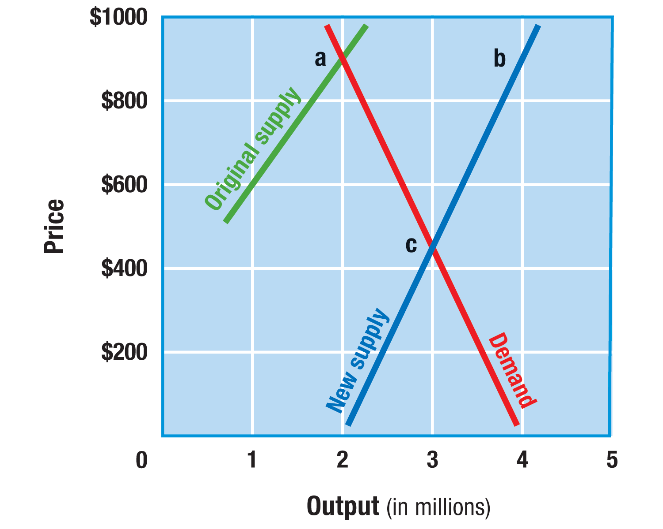
Changes in Supply
Checkpoint: What happens to the equilibrium price when the supply curve shifts to the right?
An increase in supply shifts the supply curve to the right.
This shift throws the market into disequilibrium.
Something will have to change in order to bring the market back to equilibrium.

Slide 23
A “Moving Target”
Equilibrium for most products is in constant motion.
Think of equilibrium as a “moving target” that changes as market conditions change. As supply or demand increases or decreases, a new equilibrium is created for that product.

Slide 24
Decrease in Supply
Some factors lead to a decrease in supply, which shifts the supply curve to the left and results in a higher market price and a decrease in quantity sold.
These factors include:
An increase in the costs of resources to produce a good
An increase in labor costs
An increase in government regulations

Slide 25
A Change in Demand: Fads
Fads often lead to an increase in demand for a particular good.
The sudden increase in market demand cause the demand curve to shift to the right.
What impact did the change in demand shown in the graph have on the equilibrium price?
Notes:
Answer: The change in demand increased the equilibrium price.

Slide 26
Fads and Shortages
As a result of fads, shortages appear to customers in different forms:
Empty shelves at the stores
Long lines to buy a product in short supply
Search costs, such as driving to multiple stores to find a product.

Slide 27
Reaching a New Equilibrium
Checkpoint: How is equilibrium reached after a shortage?
Eventually, the increase in demand for a particular good will push the product to a new equilibrium price and quantity.
Once a fad reaches its peak, though, prices will drop as quickly as they rose:
A shortage becomes a surplus, causing the demand curve to shift to the left and restoring the original price and quantity supplied.
New technology can also lead to a decrease in consumer demand for one product as a more high-tech substitute becomes available.
Notes:
Checkpoint Answer: The shortage becomes a surplus, which causes the demand curve to shift to the left and restoring the original quantity and price supplied.

Slide 28
Review
Now that you have learned how changes in supply and demand affect equilibrium, go back and answer the Chapter Essential Question.
What is the right price?

Slide 29
Chapter 6: Prices Section 3

Slide 30
Objectives
Identify the many roles that prices play in a free market.
List the advantages of a price-based system.
Explain how a price-based system leads to a wider choice of goods and more efficient allocation of resources.
Describe the relationship between prices and the profit incentive.

Slide 31
Key Terms
supply shock: a sudden shortage of a good
rationing: a system of allocating scarce goods and services using criteria other than price
black market: a market in which goods are sold illegally, without regard for government controls on price quantity

Slide 32
Introduction
What roles do prices play in a free market economy?
In a free market economy, prices are used to distribute goods and resources throughout the economy.
Prices play other roles, including:
Serving as a language for buyers and sellers
Serving as an incentive for producers
Serving as a signal of economic conditions

Slide 33
Price as an Incentive
Prices provide a standard of measure of value throughout the world.
Prices act as a signal that tells producers and consumers how to adjust.
Prices tell buyers and sellers whether goods are in short supply or readily available.
The price system is flexible and free, and it allows for a wide diversity of goods and services.

Slide 34
Prices as a Signal
Prices can act as a signal to both producers and consumers:
A high price tells producers that a product is in demand and they should make more.
A low price indicates to producers that a good is being overproduced.
A high price tells consumers to think about their purchases more carefully.
A low price indicates to consumers to buy more of the product.

Slide 35
Flexibility of Prices
Prices are flexible, which means they can be increased to solve problems of shortage and decreased to solve problems of surplus.
Raising prices is one of the quickest ways to solve a shortage. It reduces quantity demanded and only people who have enough money will be able to pay the higher prices. This will cause the market to settle at a new equilibrium.

Slide 36
Free Market v. Command
Free market systems based on prices cost nothing to administer.
Central planning, on the other hand, requires a number of people to decide how resources are distributed, such as in the former Soviet Union.
Unlike central planning, free market pricing is based on decisions made by consumers and suppliers.

Slide 37
Consumer Choices
In a free market economy, prices help consumers choose among similar products and allow producers to target their customers with the products the customers want most.
In a command economy, production is restricted to a few varieties of each product. As a result, there are fewer consumer choices.

Slide 38
Rationing & the Black Market
In a command economy, or in a free market economy during wartime, shortages are common.
One response to shortages is rationing.
Since the government cannot track all of the goods passing through the economy, people sometimes conduct business on the illegal black market in order to bypass rationing.

Slide 39
Rationing During WWII
During World War II, the federal government used rationing to control shortages.
Each family was given tickets for such items as butter, sugar, or shoes. If you used up your allotment, you could not legally buy these items again until new tickets were issued.

Slide 40
Efficient Resource Allocation
The free market system allows for efficient resource allocation, which means that the factors of production will be used for their most valuable purposes.
Efficient resource allocation works with the profit incentive. Producers will use the resources available to them to ensure the greatest amount of profit.

Slide 41
The Profit Incentive
In The Wealth of Nations, Adam Smith wrote that businesses do best when they provide what people need.
Financial rewards motivate people. How have you provided or benefited from the profit incentive?
Notes:
Answer: Answers will vary.

Slide 42
Market Problems
Checkpoint: Under what circumstances may the free market system fail to allocate resources efficiently?
Imperfect Competition
Can affect prices, which in turn affect consumer decisions
Negative Externalities
Side effects of production, which include unintended costs
Imperfect Information
Prevents a market from operating smoothly
Notes:
Checkpoint Answer: During times of shortage or recession and depression.

Slide 43
Review
Now that you have learned what roles prices play in a free market economy, go back and answer the Chapter Essential Question.
What is the right price?

